Slide 1
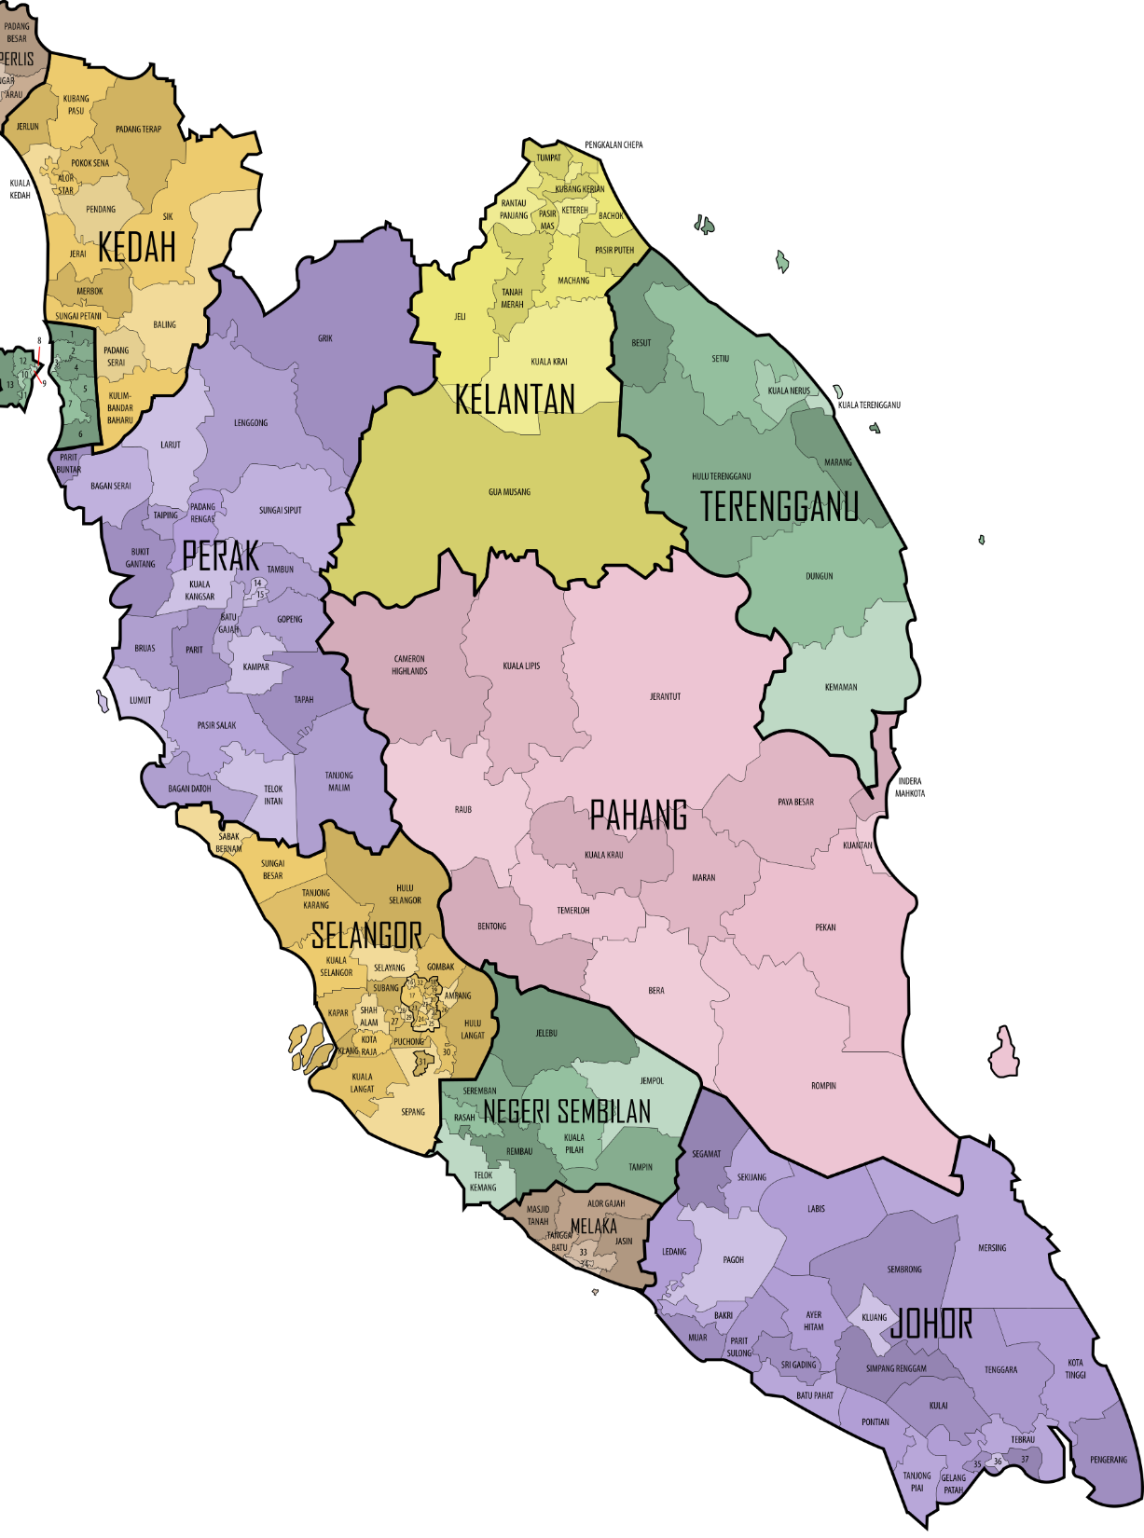
CSP600: CHAPTER 1
Malaysia Election Data Visualization using Choropleth Representation
MUHAMMAD NADZMI BIN MOHAMED IDZHAM
2015125573

Slide 2
Background study
What is data visualization?
Way to visualize data (to make data understandable faster & easier)
Types:
Explanation
show the meaning of the data to the audience.
Exploration
help the audience in discovering the meaning of the data.
Why data visualization?
Gillet(2014) stated that visuals makes the process of learning of a subject much faster than learning with texts.
Balm(2014) also showed that most of the human brains makes use of the visual processing because our brains are active towards bright colors.
it is much slower to read an information rather than visualizing it.
we need the help of visuals to understand the complex message of science.

Slide 3
What is choropleth map?
Display divided geographical areas in relation to a data variable (Ribecca, n.d.).
The regions are:
Coloured or
Shaded or
Patterned
Visualize values over a geographical area
show patterns across the displayed location.
Why choropleth map?
Mostly used political boundaries as the map’s regions (Skau, 2012).

Slide 4
Problem statement
Election data:
Consist of multiple information about the general elections that was previously held.
Problem:
Hard to be understood by the public (Done, 2010).
Viewers need to analyze each of the data in details before they can understand the data and the stories behind it (Steele, 2012).
Method:
Data visualization
help the people to analyze the election data much faster and easier (Gentile, 2014).

Slide 5
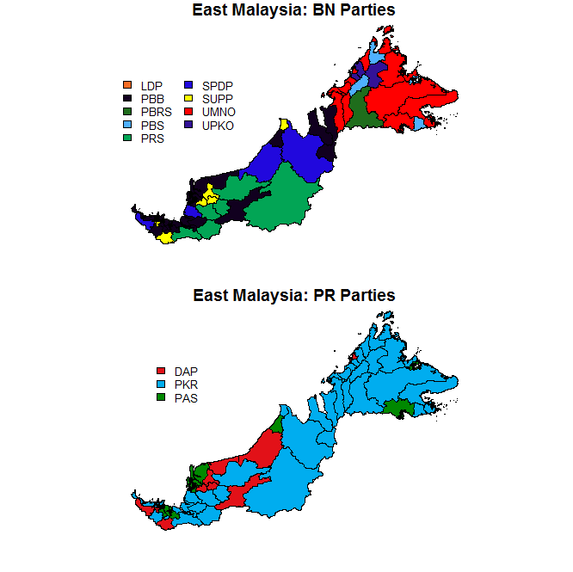

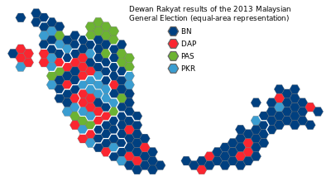
Example of current election data visualization

Slide 6
Objectives
To identify the data visualization techniques.
To the chosen technique to Malaysia election data.
To validate the chosen technique with the actual election data and the users.
Notes:
a

Slide 7
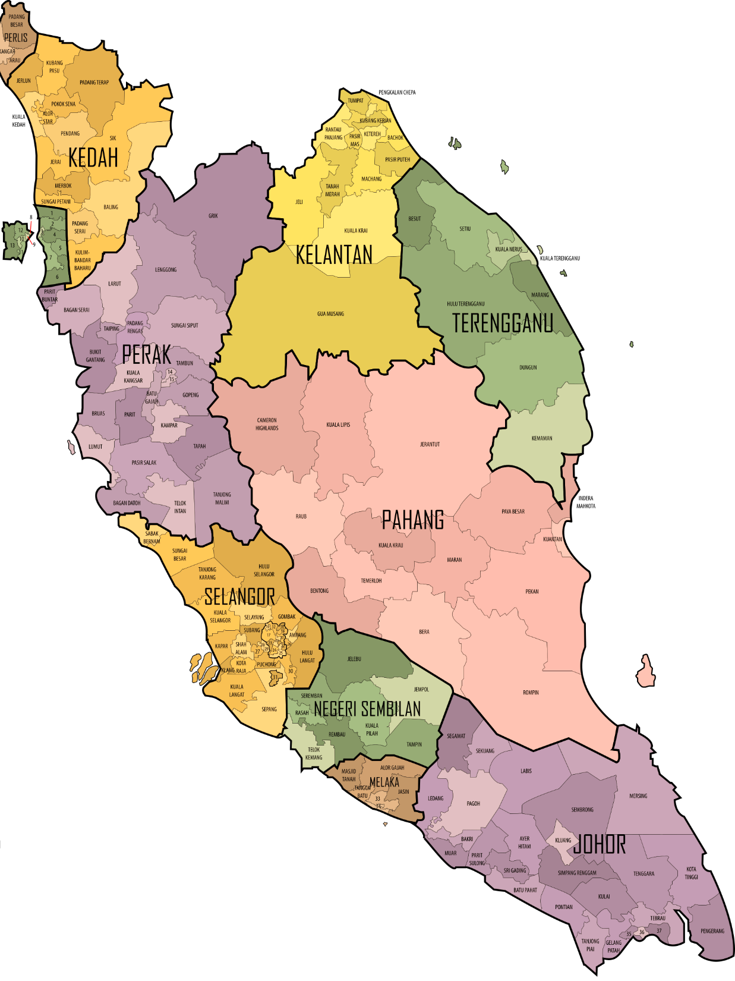
Scope
Malaysia election data
based on the Malaysian Parliament.
map used in this project are the map of Malaysia
states divided into multiple regions based on the Parliament.
Data visualization
Election data
Malaysia election data visualization
(Based on parliaments)

Slide 8
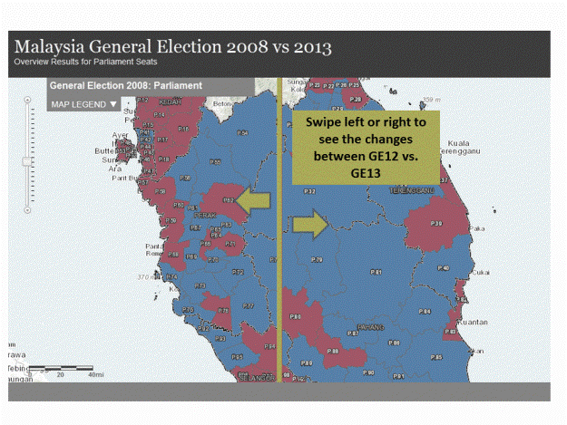
Significance
Political figures:
Understand their current political condition.
Improve themselves.
Plan their strategy for next election.
Public audience:
Understand the political condition of the country easier and faster.
Understand the election data without much prior training or knowledge.
Data scientist:
Learn the relationship between the data much faster.
Learn the technique of visualizing the data and implement them to other types of data.

